Slide 1
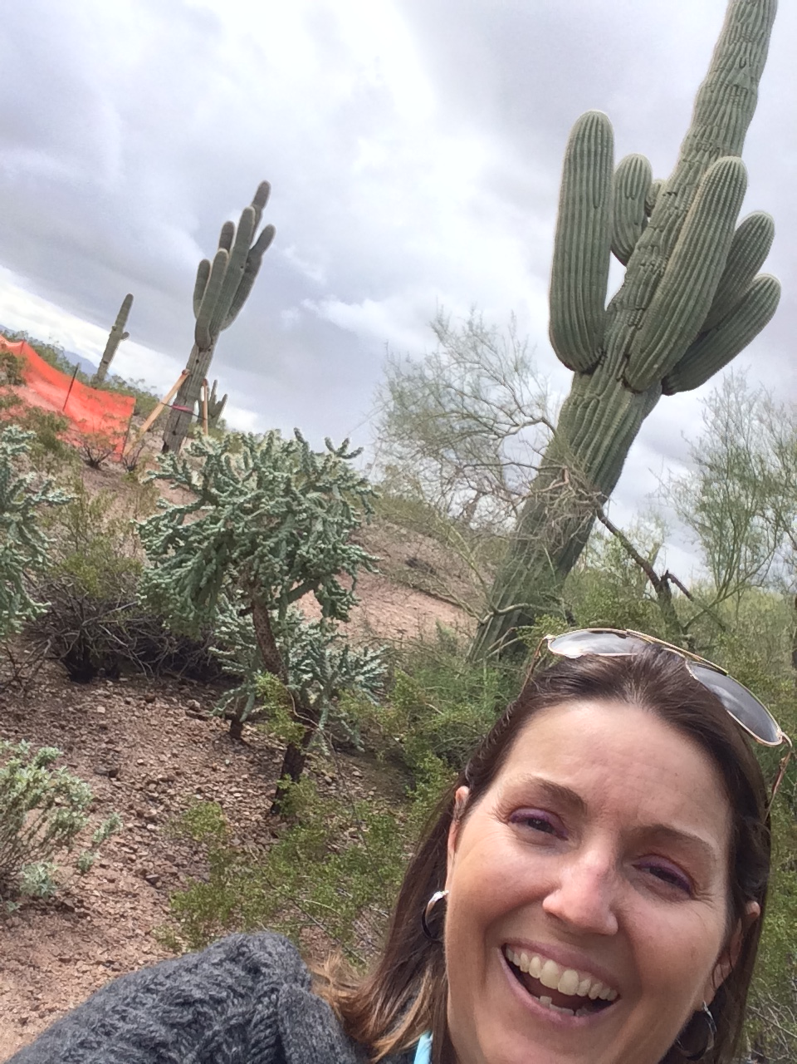
Togetherness, Wonder, Transformation
Elaine Fritz, Master Gardener Southdakotamastergardener.com
Horticulture Therapy, Garden Education
Tell me about your gardening!!
I want to give you information your always wondering about.
Please fill out your card, and drop it in the basket.
Feel free to write on the back.
If I don’t get to your question today, I will email you, personally, your answer.
Don’t forget your email.

Slide 2
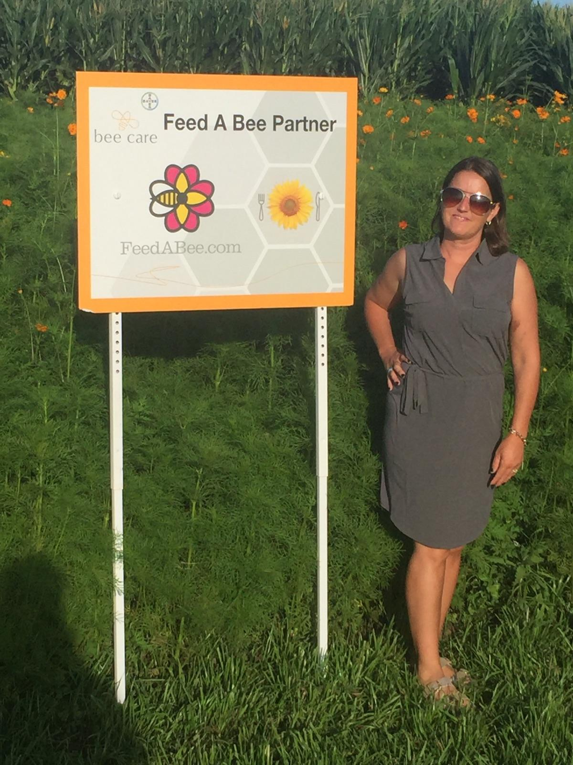
Head Over to: southdakotamastergardener.com
Download the presentation. It’s free.
I know your phone is out.
If you want to refer back to this presentation, or contact me.
Go To:
southdakotamastergardener.com
Download the presentation
Leave me a question
Please comment on the presentation
Please tell me where you saw the presentation

Slide 3
3 Easy Steps: Gardening With Special Needs Kids
HORTICULTURE THERAPY
ELAINE FRITZ, Master Gardener

Slide 4
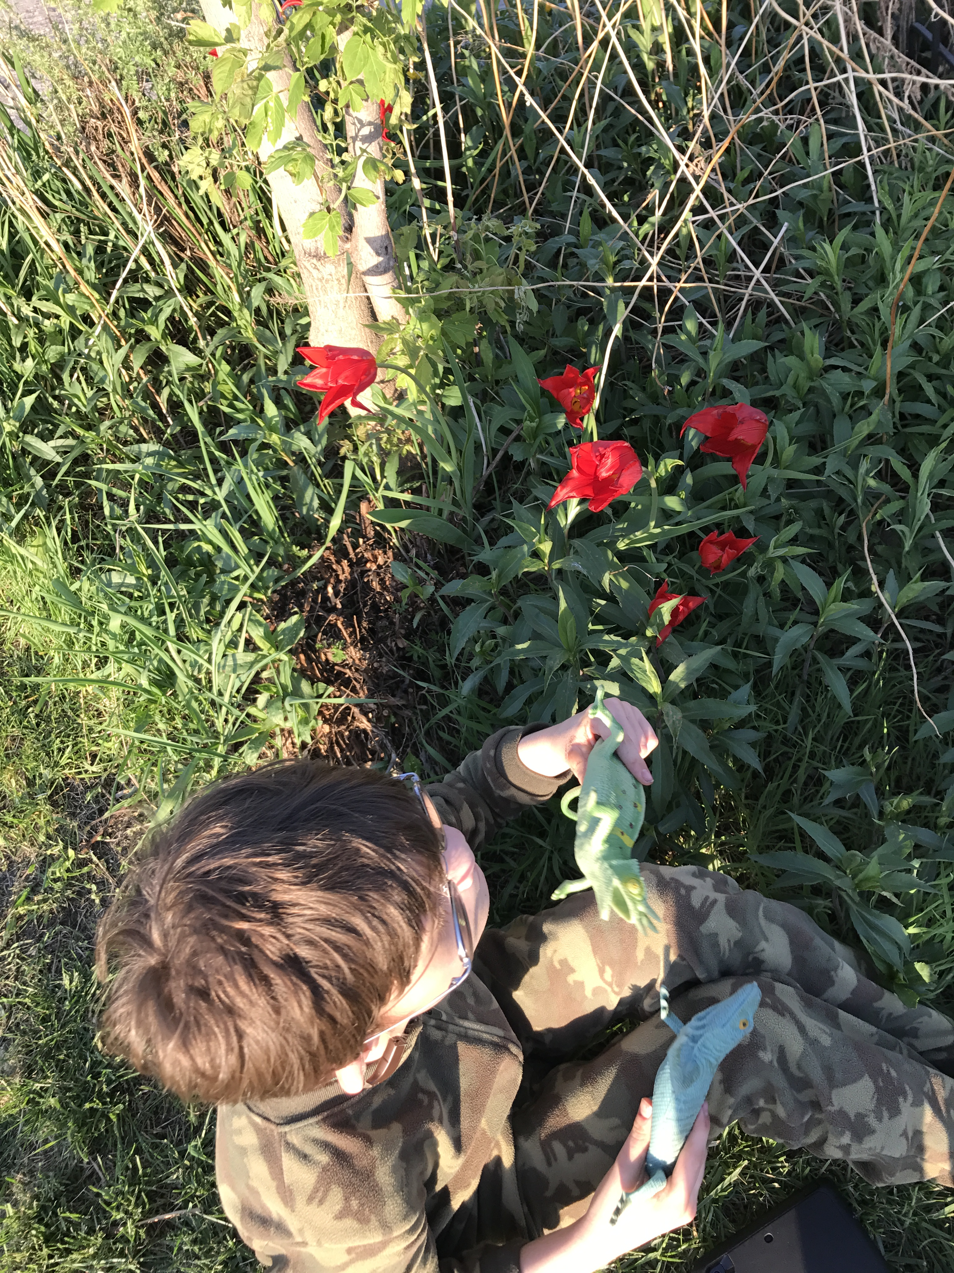
What is horticulture therapy?
Using the life enhancing activities of gardening to connect nature to Individual Education Goals, or physical therapy, occupational and speech therapy.
Direct treatment
Defined goals
Purposeful gardening activity

Slide 5
Settings
Simple Potted Plant
Outdoor Garden or yard
Botanical Garden
Local Park or school playground
At home

Slide 6
Types
Vocational
Rehabilitation
Social or wellness

Slide 7
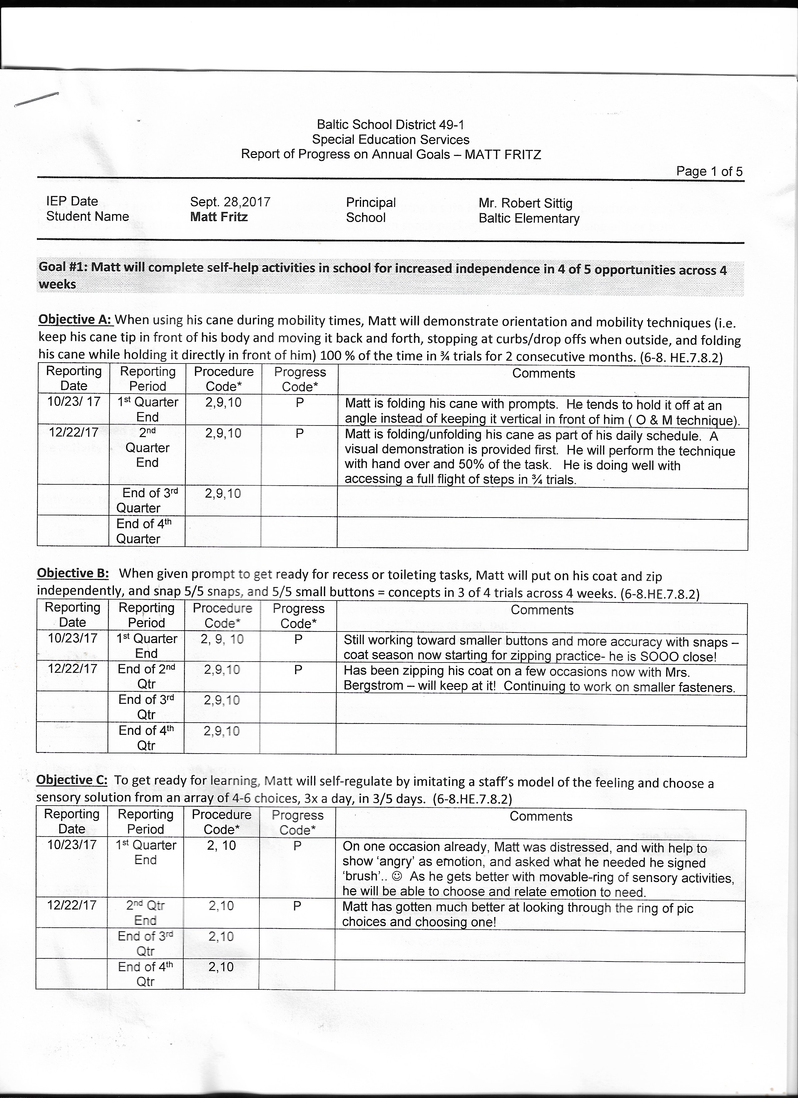
Lets Look at Individual Education Plans
(IEP/IFSP)
An IEP/IFSP is a legal document compiled by a team in the school district.
Early intervention identified, and a referral is made for formal assessments.
After determining where the child is at, and what the needs are, a team of professionals is assembled by the school district, and a meeting is held to make an intervention plan

Slide 8
GOALS
A team of professionals determine the goals after assessment is made
, OT, Speech, Deafblind Project Coordinator, SDSBVI consultant, SDSD consultant, Special Ed director, Class room teacher, intervenor, parents, ASL interpreter

Slide 9
Goals have to be S.M.A.R.T
Specific: Matt will complete self-help activities in school for increased independence in 4 of 5 opportunities across 4 weeks.
Measurable: Tests, observations, work samples, skill-based information
success would be considered if he can to the task, 4 out of 5 times
Achievable: Is it possible for Matt to even do it?
Relevant: The objectives relate to each other and to the main goal
Time-bound: 4 weeks
Speech, OT, PT, special education teacher each get an objective
(this keeps the IEP from having too many things the team is working on.(relevant) I follow Warrant Buffets 25/5/1 goal setting technique. And since I’m the mom, I’m the boss)

Slide 10
Goal #1: How does this relate to Horticulture Therapy?
Matt will complete self-help activities in school for increased independence in 4 of 5 opportunities across 4 weeks
HORTICULTURE THERAPY OBJECTIVE:
In the garden setting, Matt will independently choose seeds and plants to plant, plant them left to right, use the trowel properly, fill a watering can and water plants and seeds.
Since gardening is a dynamic process, I would make different objectives as the garden grows.

Slide 11
ACTIVITY: GARDEN THEME SENSORY BIN
Fine Motor Skills
Hand Eye Coordination
Language
Colors
Counting
Size
SHOPPING LIST:
Container
OBJECT REPRESENTS SENSE
Coffee bean Dirt Smell, Touch
Gloves Touch
Carrots Touch
Trowel Touch
Seeds Touch
Carrot Bubbles
Rubber ladybugs insects Touch

Slide 12
This is a combination of real life objects and pretend
Expose Matt to actual garden objects
Learn and sign what they objects are called
Increase Flow
Safe project to explore
Listen and follow directions
Work and bond with someone

Slide 13
As Skills increase you can transition to actual gardening materials:
Change beans to potting soil
Water the newly planted seeds and plants
Work in a pot or raised bed
Go outside and garden for real

Slide 14
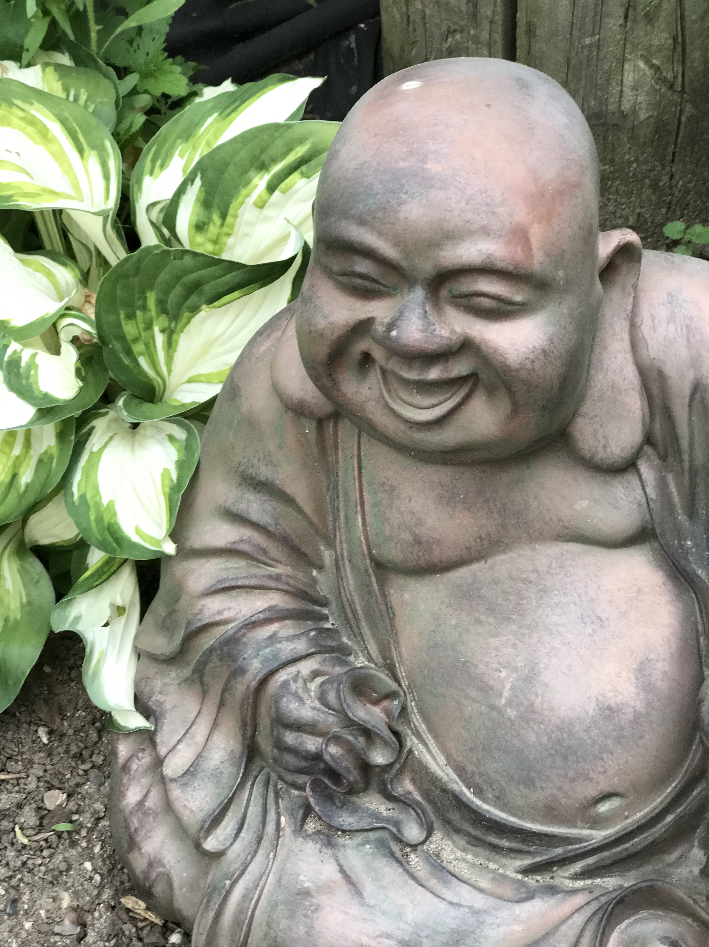
Gardening for Wellness Therapy
Vegetable gardening can inspire people to eat more vegetables if they grow the vegetables themselves and the plants grown are relevant to the person
Example: A woman ( we will call her Ann-Nancy) on “My 600 Pound Life” has shame and ridicule from her family around vegetables, and any kind of exercise. Her doctor has told her when she can walk for ten minutes without stopping for a break, she can have the surgery she needs to loose the dangerous weight. Her therapist suggests that next week they meet her friend Elaine, a horticulture therapist at her studio and garden. They sit down for unsweetened ice tea to talk in Elaine's Japanese Style garden. Elaine makes an assessment based on the conversation and they create simple achievable goals where togetherness, wonder and transformation is expected.

Slide 15
Ann-Nancy’s Goal’s
(This is what came out of their chat)
Diagnosis: Treatment Focus Horticulture Therapy Strategy
Obese neglect of proper nutrition Offer plant care activities that reflect healthy eating and healthy care habits watering fertilizing deadheading
Poor Mobility Low motivation & energy level Offer gardening activities
lack of pleasure in activities that require moving around
difficulty initiating tasks due to lack the garden
of mobility
Depressive Use plants as a metaphor for self-care, what do the plants and
Disorders people need to survive?
Prepare plants as gifts
Theme garden for healthy eating/cook-out when plants ready
Use plant care to gain a sense of accomplishment
Provide a tranquil space for journaling & self reflection

Slide 16
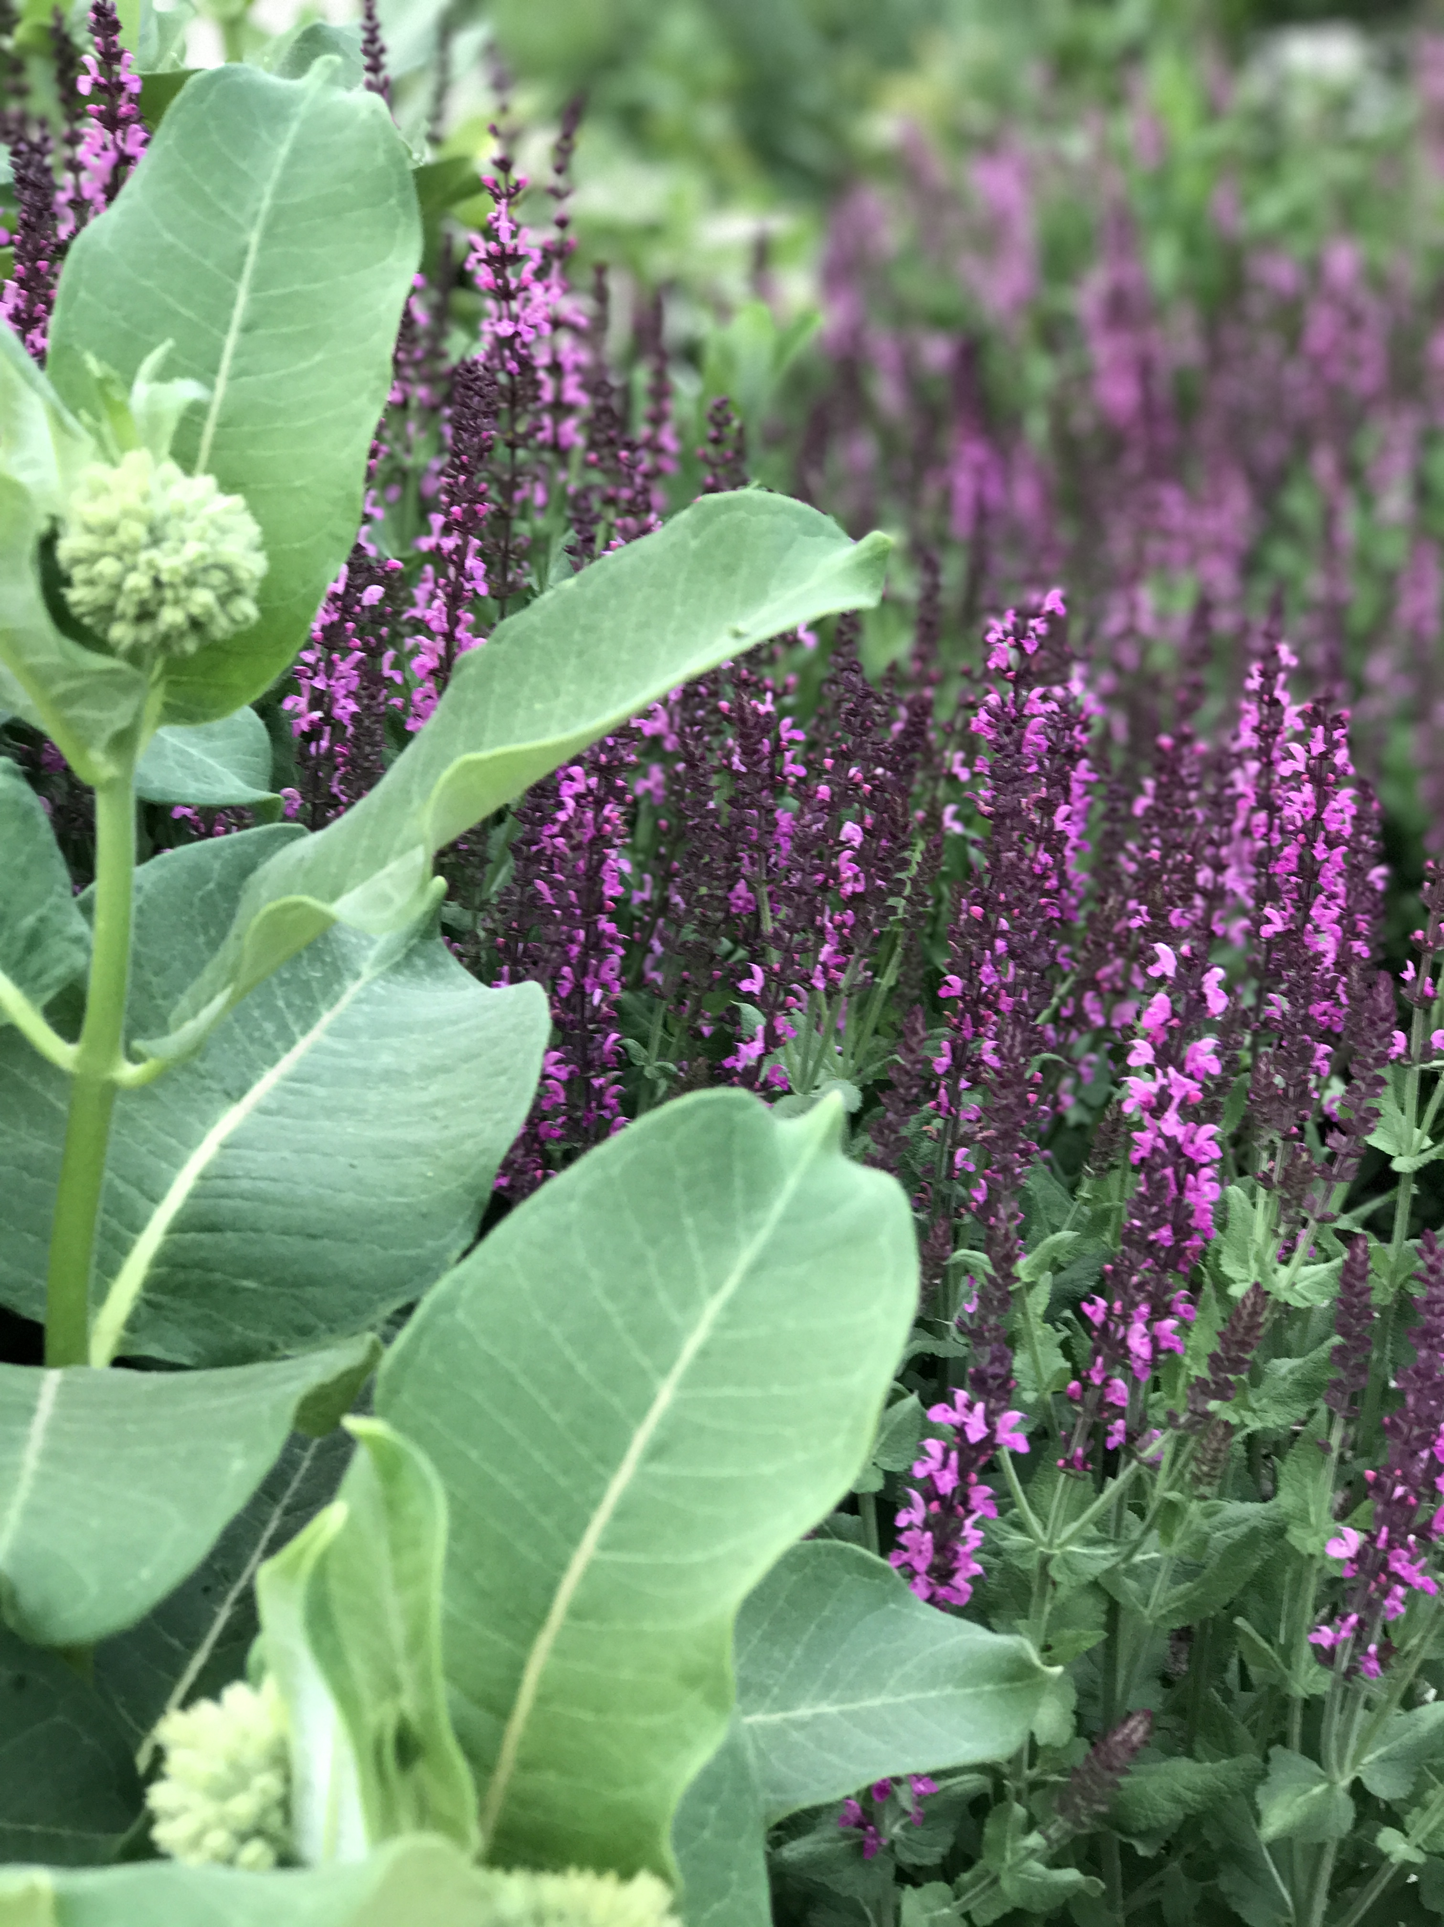
Ann-Nancy’s Results:
Togetherness, Wonder, Transformation
Ann-Nancy enjoys coming to the garden.
She comes a little early and enjoys garden fresh fruit & veggies, and ice cold unsweetened tea in the tranquility garden where she journals, writes poems. Sometimes she sits and watches the birds and butterfly's. She especially enjoys walking through the sensory gardens smelling the fresh herbs. She's looking forward to the scheduled cooking class and is kind of excited to meet people who enjoy fresh veggies cooked from the garden. She likes this time away from her negative family.
She has been working with Elaine in the vegetable garden. So far she has learned the pleasure of growing her own fresh salad. Ann-Nancy and Elaine have a fresh from the garden lunch after every session.
Ann-Nancy is considering volunteering at McCrory Gardens because gardening has given her so much intrusive value. She enjoys the school children and gives tours in the vegetable garden when the kids come.
She is considering the master garden program the next time it’s offered in Brookings. She has lost the weight she needs to get the surgery and learned to eat healthier. She now enjoys the please of a home grown tomato.

Slide 17
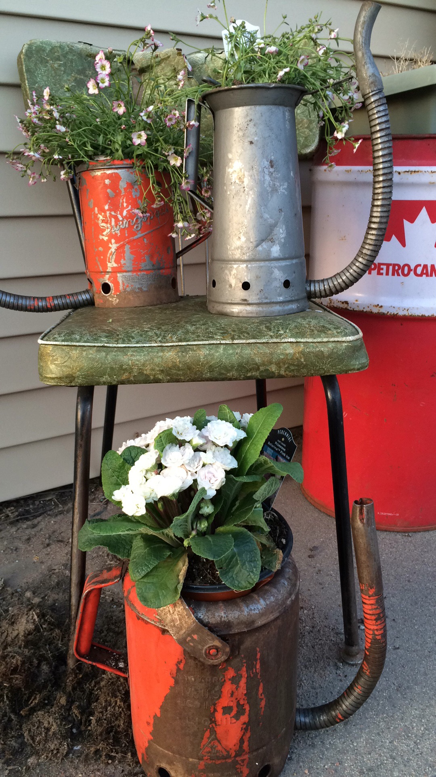
Togetherness, Wonder, Transformation
This is a extreme example, a powerful example of how gardening can impact someone's life.
It doesn’t have to be this extreme.
But my dream is that its this transformative for everyone.

Slide 18
Meditation Garden:
Your Own Wonder & Transformation
Butterfly Banquet (source Container Theme Gardens. Nancy J. Ondra)
Sunny Spot
Shopping list:
Container 24” wide 10” tall
Potting soil
‘Imagination’ Verbena (Verbena)
Lucky Peach lantana
Supertunia Sangria Charm petunia
‘Wild watermelon’ little leaf sage
Yellow Charm Biden's

Slide 19
Totally doable wellness space for your own wonder & transformation
Sunny Spot
Chair
Side table
Planted Container Butterfly Banquet
Bird Bath
Butterfly watering station
Journal or good book or magazine (no smart phone)
Giant ice tea
Bowl of fruit, or cherry tomatoes, carrots, radishes, or garden fresh salsa and corn chips, to snack on (you can get them at the farmers market if you didn’t grow them)

Slide 20
CRAFT PROJECT:
Butterfly Watering Station
Old dish (repurpose something you already have, go to a thrift store, dollar store)
Use a shallow dish
E-6000 glue (my favorite)
Glass marbles, found rocks, those shells you keep bringing back from vacation
This is for the butterfly's to land on safely
Glue the glass marbles to the dish
Add water
Feeling fancy? Add sliced oranges

Slide 21
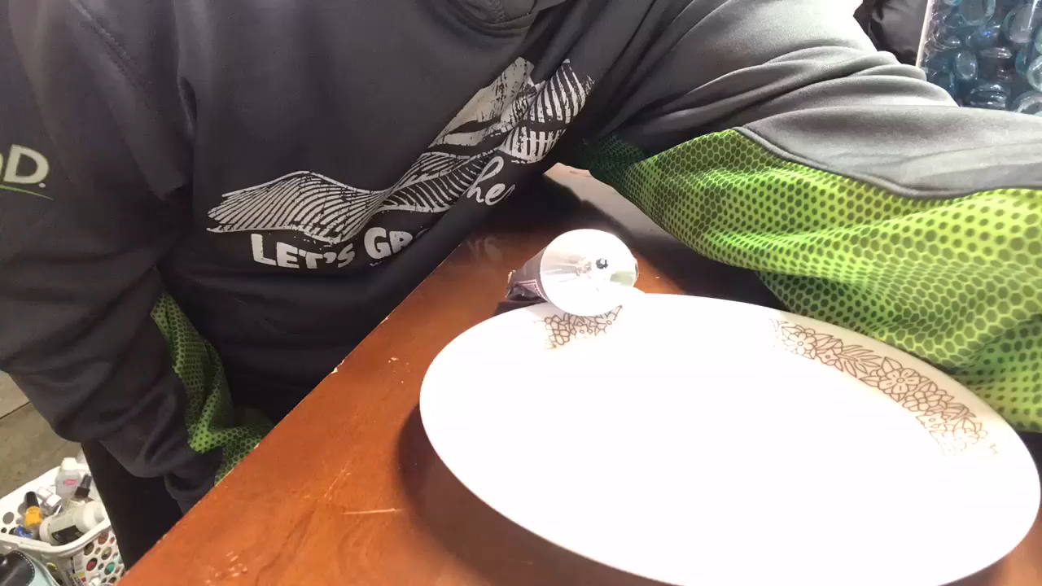
How to make a butterfly water dish from a repurposed plate…

Slide 22
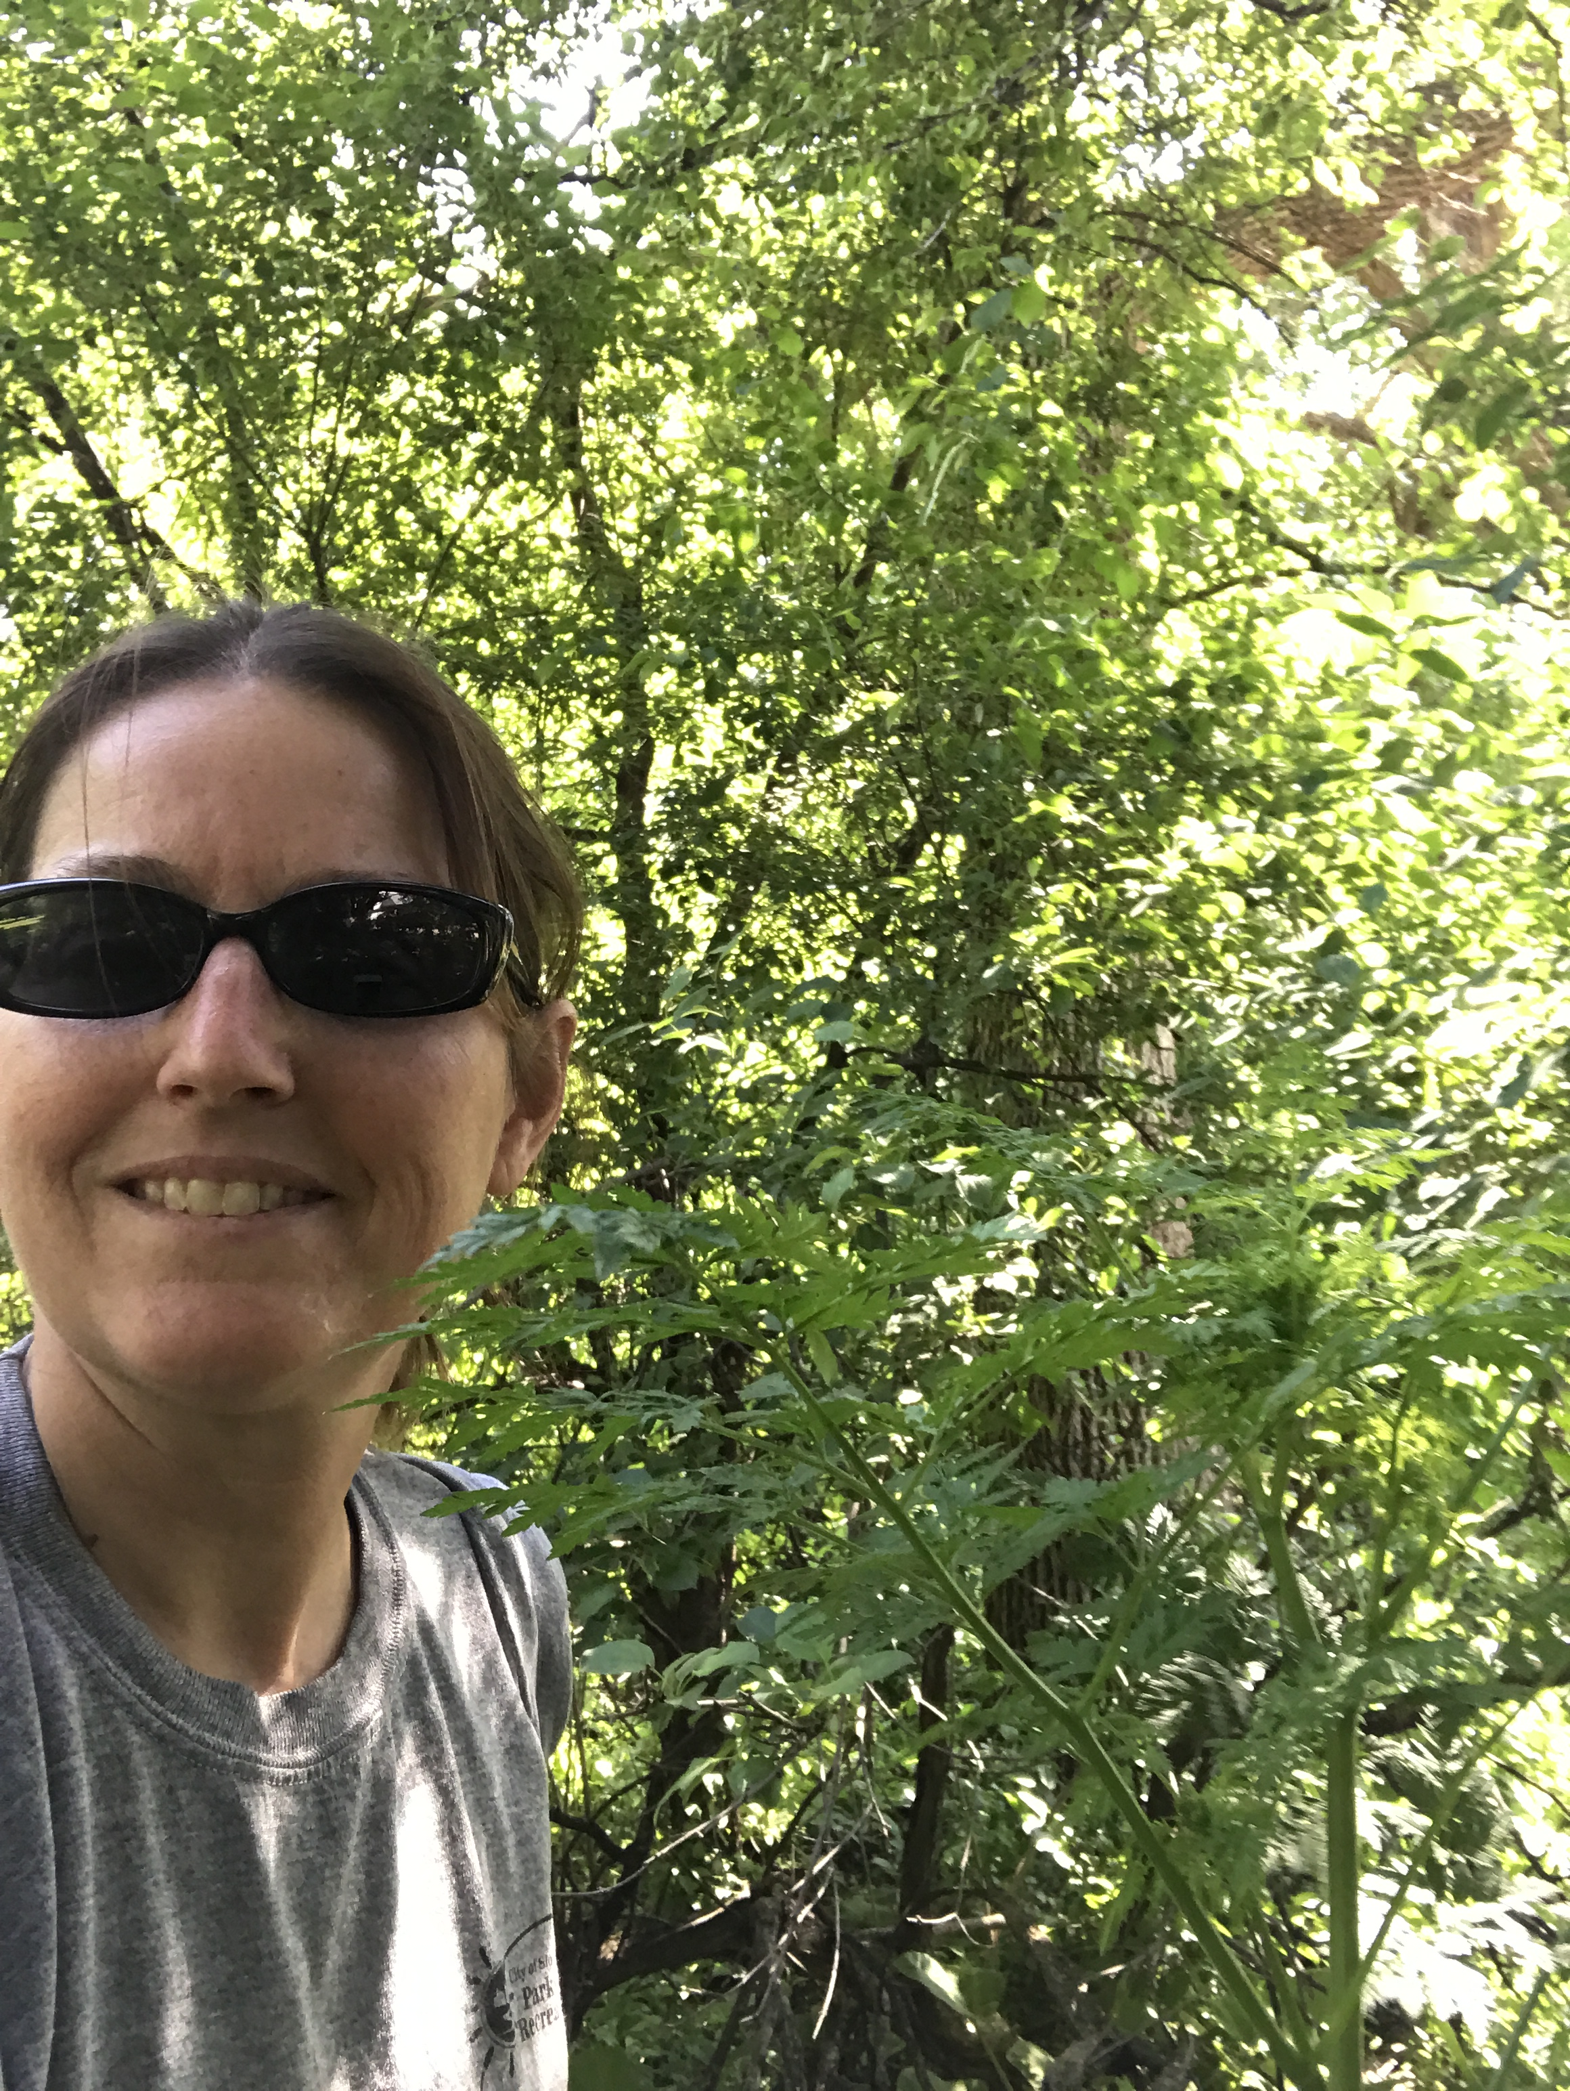
Please Visit: southdakotamastergardener.com
Facebook: South Dakota Gardener
Be sure to follow McCrory Gardens
3rd Thursday at McCrory
I will be presenting my poisonous weeds presentation

