Slide 1

TERRARIUM DESIGN
Just get growing!

Slide 2

TERRARIUM DESIGN
Just Get Growing

Slide 3
TERRARIUMS
LEARNING OUTCOMES
1. History of Terrariums
2. Desert Plants
3. Containers and Materials
4. Layers
5. Plant Care

Slide 4
History of Terrariums
Popularized in 19th century when Dr. Daniel Ward accidently created a garden in a jar.
He buried a cocoon in damp soil in a glass jar, and grass and ferns sprouted and thrived.
1882 he shipped glass-contained planters to Sydney Australia. The plants survived the 8 month voyage
This opened up global plant trade
Plants were introduced to compatible climates around the world
Provided a global selection of plant material for indoor gardening
Effective method for maintaining delicate plant species
Today a popular hobby

Slide 5
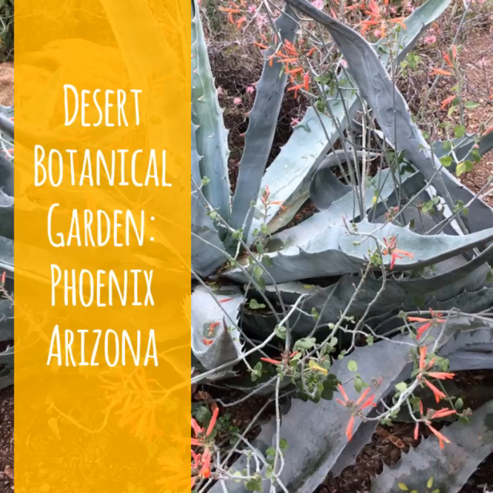
Care of Cacti in Containers

Slide 6
Care of Cacti in Containers
Filtered or bright sun
Soil mixtureof sands, silts, gravel
Water when actively growing or if it wilts
Water only when soil is nearly dry
Fertilize every 4 weeks with water soluable fertilizer
Repot when the cacti fills the pot

Slide 7
Cacti Facts
The catus family is one of the top five most threatened groups of organisims on earth
Birds, such as woodpeckers make there nests in Saguaro catus and does no harm to the plants
Cacti adapt by storing and conserving water in many ways
Have few or no leaves
Often survive by remaining dormant during long dry periods
Spring to life when water becomes available
Waxy skin or smooth green bark to seal in moisture
Spines for shade
Shallow roots

Slide 8
CONTAINERS
Great way to recycle glass and clear plastic containers
Use any type of clear container that holds moisture and transmits light

Slide 9
Materials
Clear plastic or glass container
Pebbles or gravel
Activated carbon
Proper soil mixture
Plants
Whimsical decor

Slide 10
Layers : Pebbles or Gravel
What to Use:
Aquarium gravel
Small pebbles or rocks
Marbles
Gravel on the bottom provides drainage for the terrarium.
Add about ¾ inch gravel to the bottom of the container.

Slide 11
Activated Charcoal
Activated charcoal will keep your terrarium from having a sour odor.
Sprinkle the charcoal over the gravel layer

Slide 12
Soil: Desert Mix
(different plants require different soil)
2 parts sandy potting soil
1 part peat moss
1 part perlite
OR:
1 part soilless potting mix
1 part sand
2 parts standard potting soil

Slide 13
PLANTS: CACTUS
Don’t’ over water!!
Cactus are drought tolerant plants and are susceptible to root rot.
Water sparingly, when soil is almost completely dry, around the base of the plant or use a spray bottle.
Check the sides of the container. If mist appears on the sides, you are watering your cactus too much
Set in a bright locations. Cactus like sun

Slide 14
FERTILIZER
Fertilizer should be used sparingly
Fertilizer salts can build up in the terrarium soil
Soluble fertilizer can be applied ½ as often, and at ¼ strength of manufactures recommendation
Can add bone meal once a year

Slide 15
WHISMY
After you have built your terrarium, its time to decorate it with shells, rocks, colored glass, miniatures.
Have Fun!

Slide 16
THANK YOU!! I wanna see your Terrariums!!
Elaine Fritz, Master Gardener
Facebook: South Dakota Gardener
Post your pic #sdterrarium
#siouxfallsparksterrarium
#southdakotagardener
Questions? Ask them on facebook, or email me at efritzdesign@me.com

