Slide 1
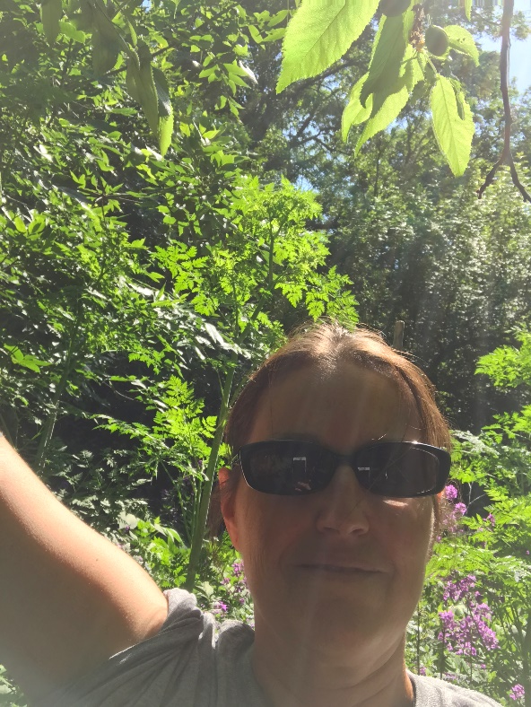
Elaine Fritz, Master Gardener
Poisonous Plants of Sertoma Park

Slide 2
POISONIOUS PLANT LEARNING OUTCOMES
BIODIVERSITY
HISTORY OF WEEDS
SAFETY WITH WEEDS
COMMON POISIONIOUS WEEDS
HIKING

Slide 3
BIODIVERSITY of Indigenous and naturalized weeds
Biodiversity, the variety and variability of life here in our tallgrass prairie, riparian areas, flood plain forests. Variability between species, and ecosystems. It is a measure of the variety of organisms present in different ecosystems. It is the food, shelter and water available

Slide 4
WEEDS
The nature of the habitat and its disturbances will effect or even determine which types of plant communities become dominant. Weeds adapt to naturally occurring disturbed environments, like shifting soil, flood plains, river banks.
They common have soil seed banks that persist in the soil for years.

Slide 5
WEED ECOLOGY
I speak of the relationship between
PLANT
PLACE
PERCEPTION

Slide 6
WEEDS
Native weeds were present in North America before Europeans came
Introduced plants were brought from other countries. Some of these become troublesome.
Although we call them weeds, rarely is a species completely worthless

Slide 7
WEEDS ARE:
Important to pheasants, and other wildlife
Important for pollinators like bees
Diversity furnishes year round benefits for wildlife, food, cover, nesting habitat
Attract insects that feed other wildlife

Slide 8
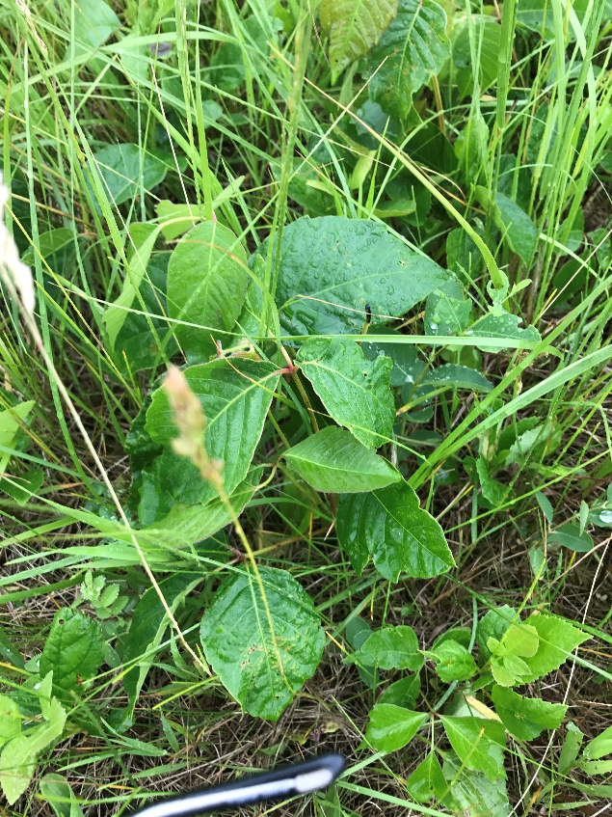
FOOD SOURCE, MEDICINE, POLLINATORS, erosion control or improve soil fertility
MANY WEEDS ARE BENIFICIAL

Slide 9
Some Toxic Weeds:
Although irritating to humans, native plants benefit wildlife by providing food sources for birds, small animals, and large browsers.

Slide 10

SAFETY WITH PLANTS
Avoid skin contact with toxic sap by:
wearing gloves
long sleeves,
pants,
sturdy shoe with socks
Do not eat unknown plants

Slide 11
What Makes A Plant Poisonous or Toxic?
Contact-irritation of the skin
Ingestion-Eaten to be toxic
  Type of Toxin
  Amount Ingested
  Sometimes light exposure
  Actual toxicity can depend on locality, age of plant, and various environmental factors

Slide 12
POISIONIOUS PLANTS
Poisonous Hemlock
Stinging Nettles
Wild Parsnip
Black Nightshade
Buckthorn (tree/shrub)
Buckeye (tree)
Virginia Creeper
Poison Ivy

Slide 13
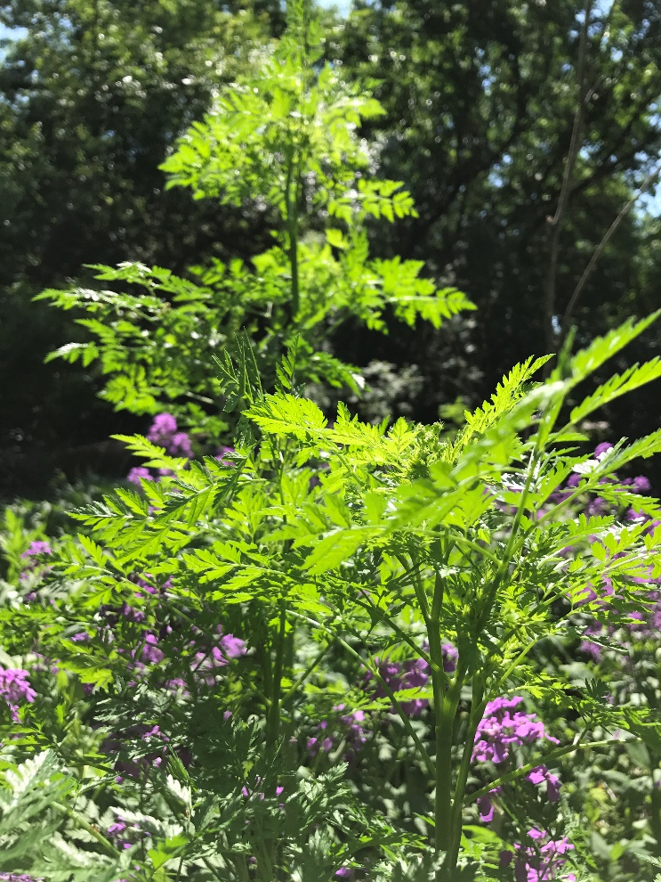
Poisonous Hemlock
Toxicity in all parts of the plant
10 feet tall
Fern like leaves
White showy flowers
Purplish strips or spots on stems
Found in shaded wet soil and disturbed waste areas

Slide 14
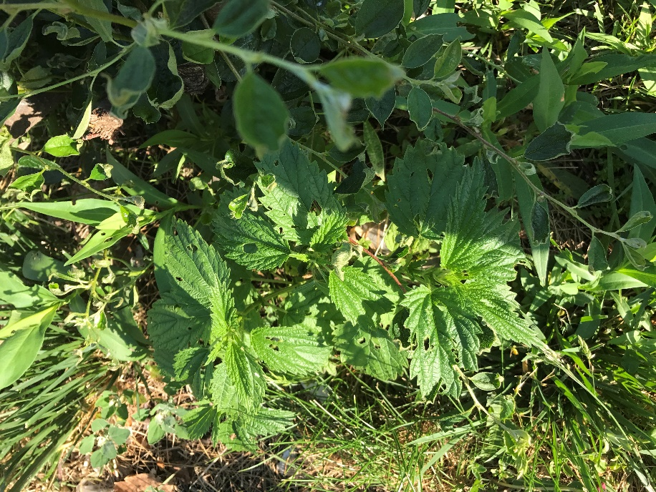
STINGING NETTLES
Native
Forb
June-September
Tall,
Stinging hairs
Stems 4-angled, ridged, grooved
Thrives in moist woodlands, thickets, along partially shaded trails
Blanched and cooked like spinach or tea

Slide 15
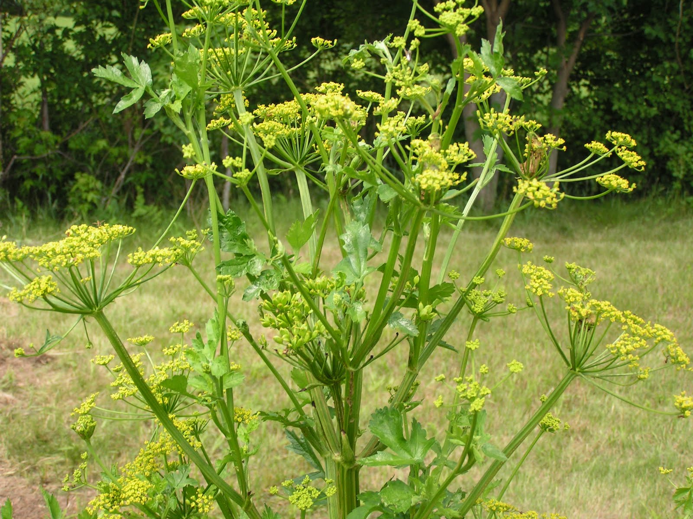
WILD PARSNIP
Plant contains psoralen, causes skin sensitivity to sunlight
Same species as root crop parsnip
Deer sometimes eat it
Birds and small mammals like the seeds
Found in pastures
1-3.5 feet tall
Yellow flowers
Look like dill

Slide 16
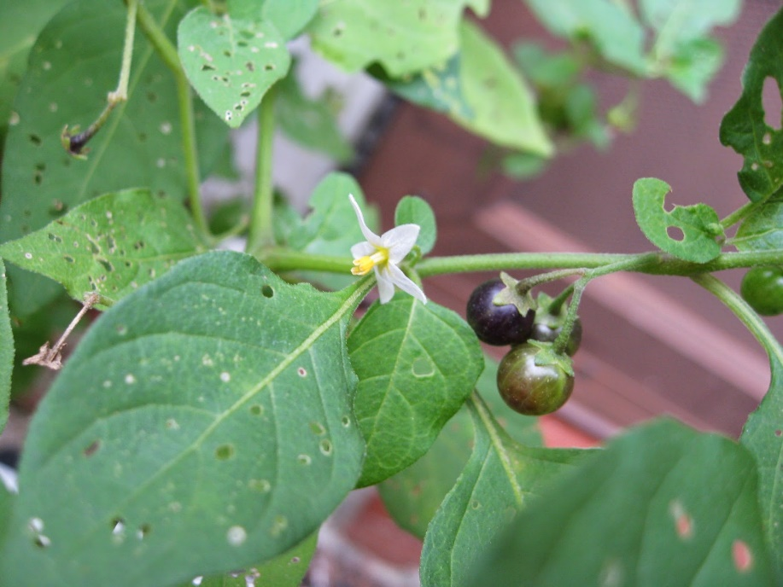
BLACK NIGHTSHADE
Native
Purplish black berry
Leaves often have insect holes
Flowers white-pale blue
Grouse and prairie chickens eat the berries
Berries and other plant parts contain alkaloid solanidine.

Slide 17
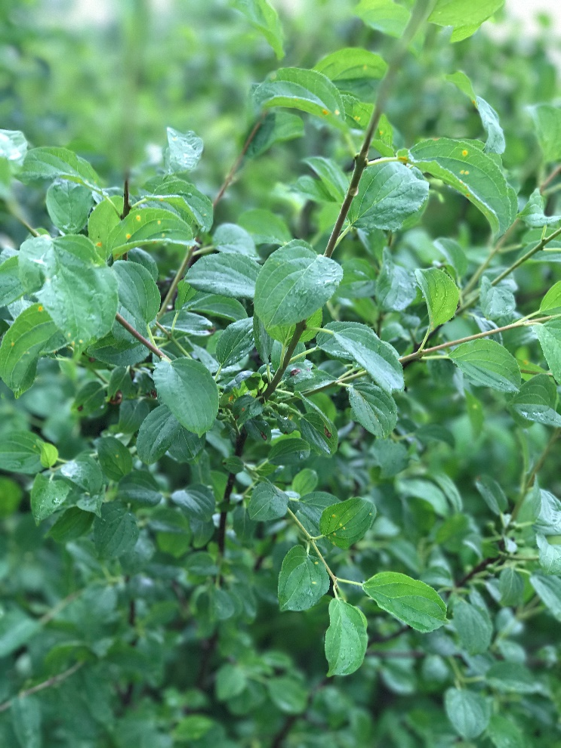
BUCKTHORN
Tall shrub or tree
Blooms in May-June
Berries on Female plants only
Leaves, bark and fruit may cause vomiting, nausea, diarrhea, minor dermatitis
Understory plant
Cut stems and treat with glyphosate in fall or winter

Slide 18
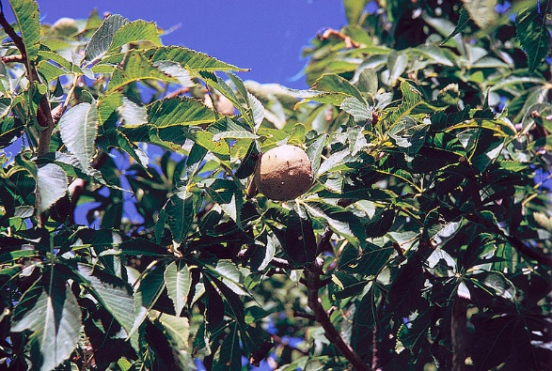
BUCKEYE
Native tree
5 palmate leaves
Round spinney nut
Contains tannic acid that is toxic
Native Americans used the nuts to tan leather

Slide 19
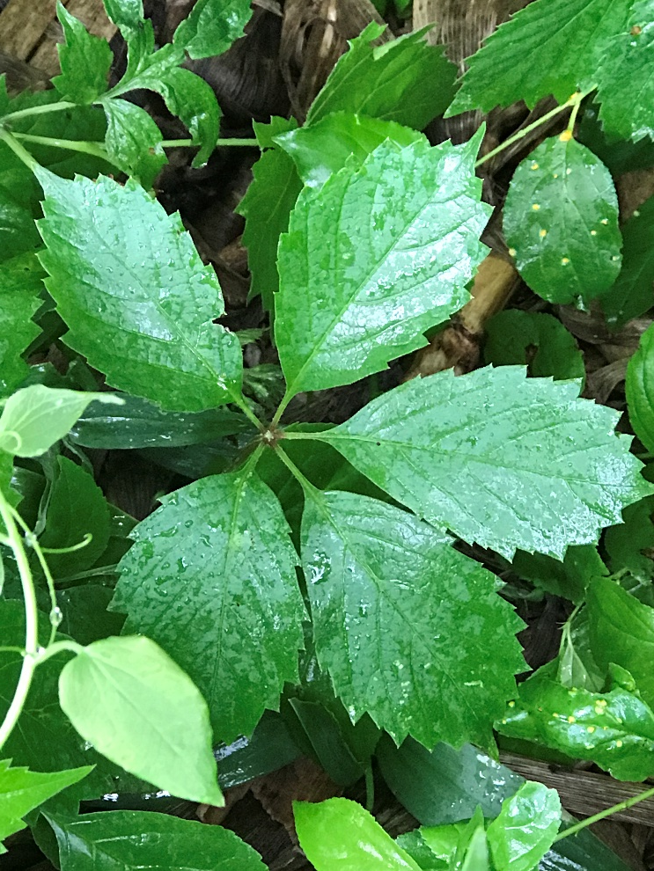
VIGINIA CREEPER
Native
Vine/climber
5 leaflets
Clusters of berries contain oxalic acid and are toxic
Not toxic for birds
Can irritate skin

Slide 20

POISION IVY
4 main characteristics
Clusters of 3 leaflets on own stem
“Leaves of 3, let it be”
Alternate leaf arrangement
Lack of thorns
“Hairy Vine, no friend of mine”
“Berries white, run in fright”
Can be a food source for birds and small mammals

Slide 21
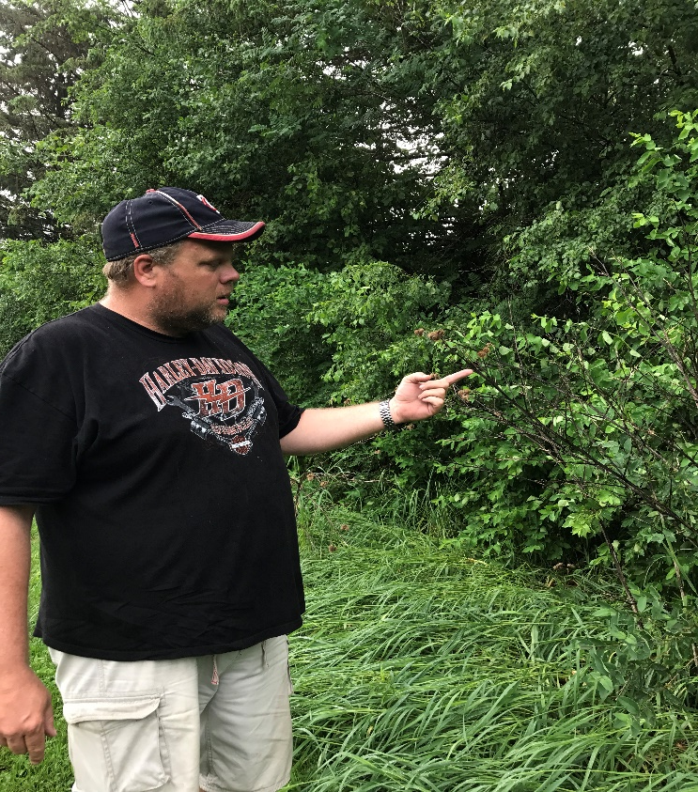
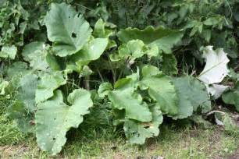
THIS IS NOT RHUBARB
Burdock has big heart shaped leaves, flowers that inspired Velcro and is toxic due to diuretic effects. Although the root is used in herbal medicine.
Rob, (AgPhD Rural Radio/HSB Farms/Hefty Seed) is 6’4”

Slide 22
THE LIST GOES ON!
There are many toxic weeds found in our area. There are too many to cover.

