Slide 1
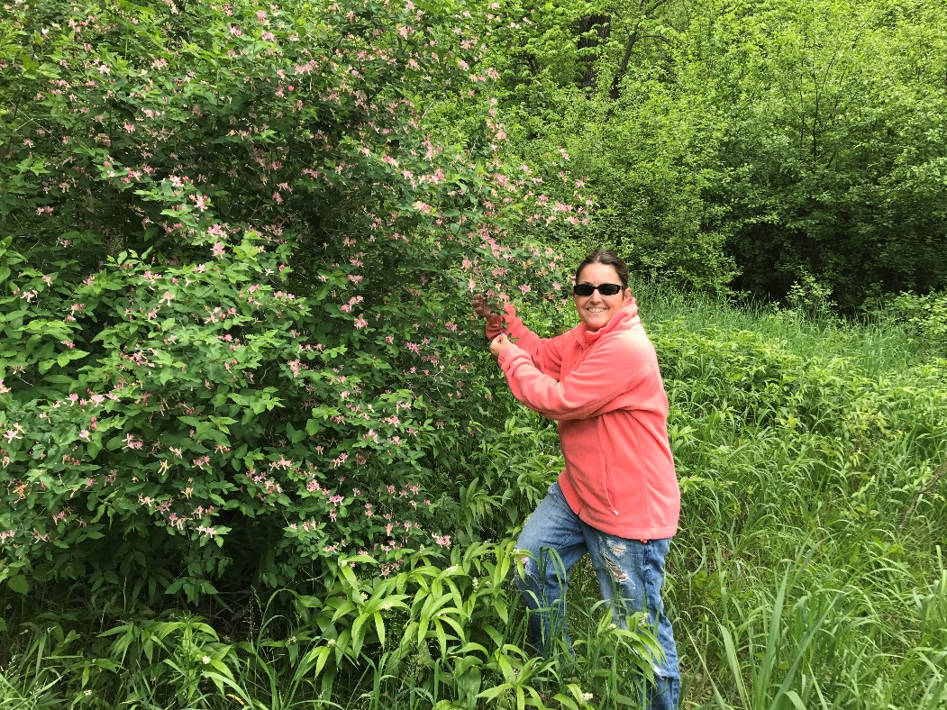
Elaine Fritz, Master Gardener
Foraging for edible plants
Tallgrass Prairie

Slide 2

OUR HOME: Coteau des Prairies
Welcome to the start of a new adventure!
Thick glacial deposits. The remnants of many glaciations have blessed us with tallgrass prairies, prairie pot-holes, riparian areas, flood plain forests,
and oak savannas.

Slide 3
EDIBLE LEARNING OUTCOMES
HISTORY
BIODIVERSITY
PLANT IDENTIFICATION
COMMON EDIBLE WEEDS
METHODS of FORAGING & HARVEST

Slide 4
History of Foraging
Hunting and gathering. The Lakota followed the buffalo herds. They gathered fruit, nuts, and berries along the way. They also harvested wild rice and indigenous herbs and greens, honey and maple syrup.

Slide 5
BIODIVERSITY of Indigenous and naturalized weeds
Biodiversity, the variety and variability of life here in our tallgrass prairie, riparian areas, flood plain forests. Variability between species, and ecosystems. It is a measure of the variety of organisms present in different ecosystems. It is the food, shelter and water available

Slide 6
WEEDS
The nature of the habitat and its disturbances will effect or even determine which types of plant communities become dominant. Weeds adapt to naturally occurring disturbed environments, like shifting soil, flood plains, river banks.
They common have soil seed banks that persist in the soil for years.

Slide 7
WEED ECOLOGY
I speak of the relationship between
PLANT
PLACE
PERCEPTION

Slide 8
WEEDS
Native weeds were present in North America before Europeans came
Introduced plants were brought from other countries. Some of these become troublesome.
Although we call them weeds, rarely is a species completely worthless

Slide 9
WEEDS ARE:
Important to pheasants, and other wildlife
Important for pollinators like bees
Diversity furnishes year round benefits for wildlife, food, cover, nesting habitat
Attract insects that feed other wildlife

Slide 10
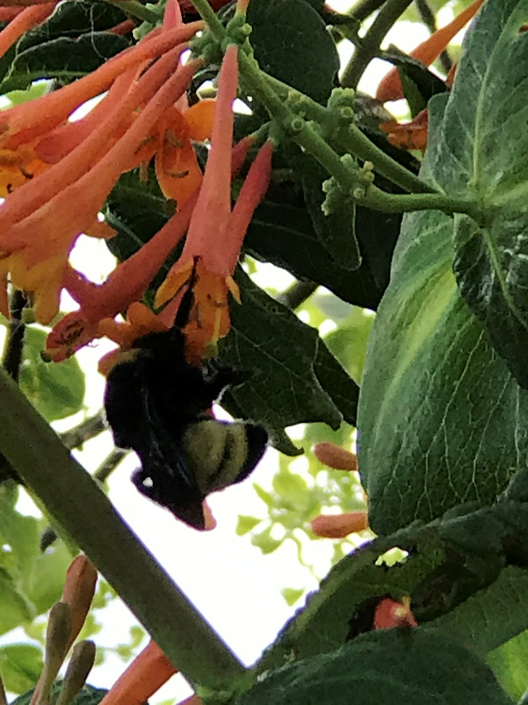
FOOD SOURCE, MEDICINE, POLLINATORS, erosion control or improve soil fertility
MANY WEEDS ARE BENIFICIAL

Slide 11
EDIBLE PLANTS
Asparagus
Dandelions
Stinging Nettles
Purslane
Broadleaf Plaintain
Sunflowers
Ground Cherries
Black Walnuts
Mulberry
Rose Hips
Catnip

Slide 12
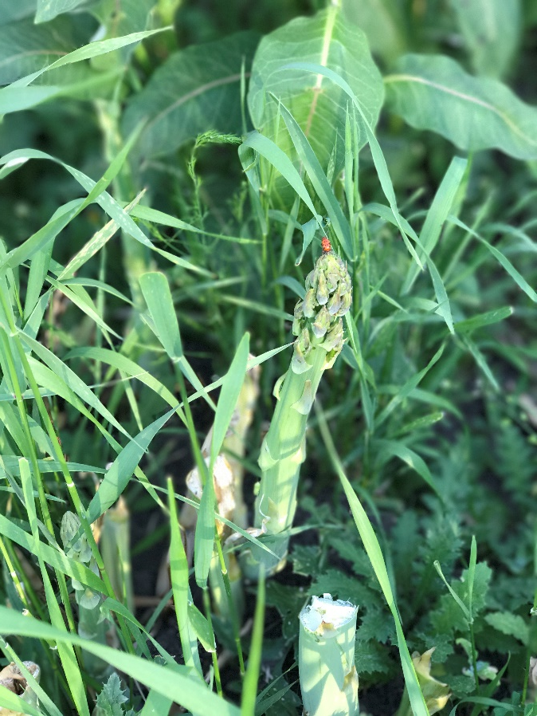
ASPERAGUS officinalis
Native to most of Europe, northern Africa, western Asia
Escaped Vegetable Plant
Herbaceous Perennial
Stout stems
Feather foliage
Stir fry, steamed, grilled, raw in salads

Slide 13
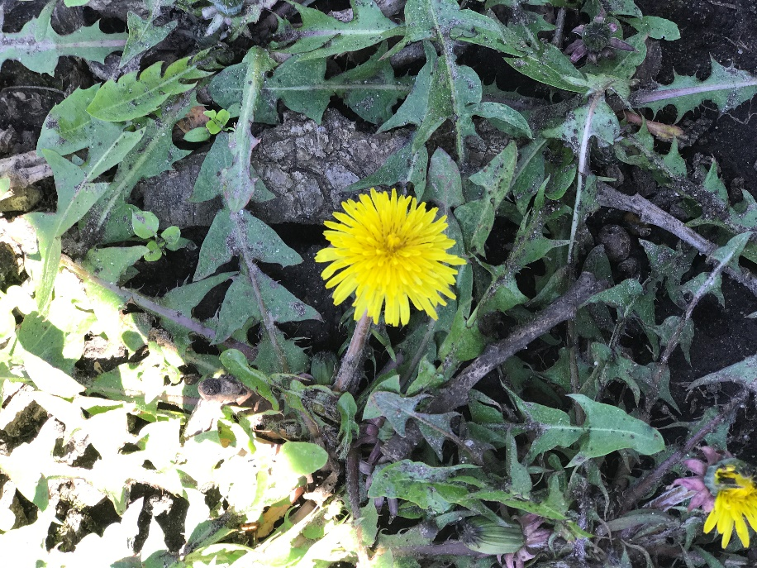
DANDELIONS
Forb
Perennial
April-October
Young leaves boiled and eaten as spring greens, tea and wine, flowers battered and fried

Slide 14
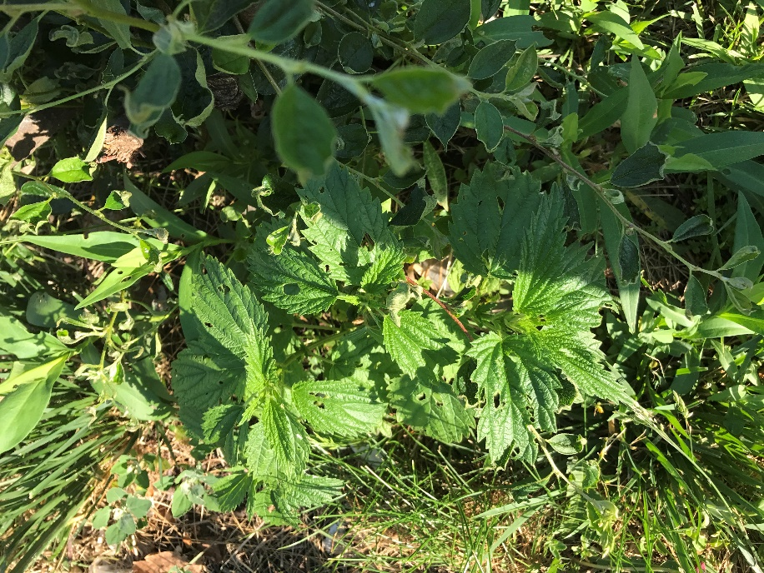
STINGING NETTLES
Native
Forb
June-September
Tall,
Stinging hairs
Stems 4-angled, ridged, grooved
Thrives in moist woodlands, thickets, along partially shaded trails
Blanched and cooked like spinach or tea

Slide 15
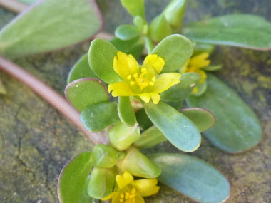
PURSLANE
Poor soil
Sidewalk cracks
Used in soups salads, cooked vegetable
Thick red stems, succulent leaves

Slide 16
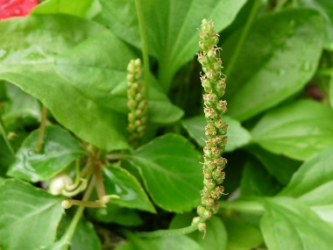
BROADLEAF PLAINTAIN
Oval leaves growing in a rosette
Thick stems that meet at the base
String like veins
Entire plant is edible

Slide 17
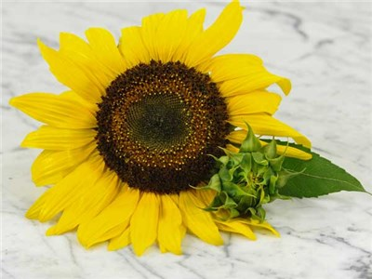
SUNFLOWERS
Course, hairy, stiff stalks
1-2 meters high
Dry sunny areas, roads, fences, fields
Native
Small, seeds, sprouted seeds, steam flower buds

Slide 18
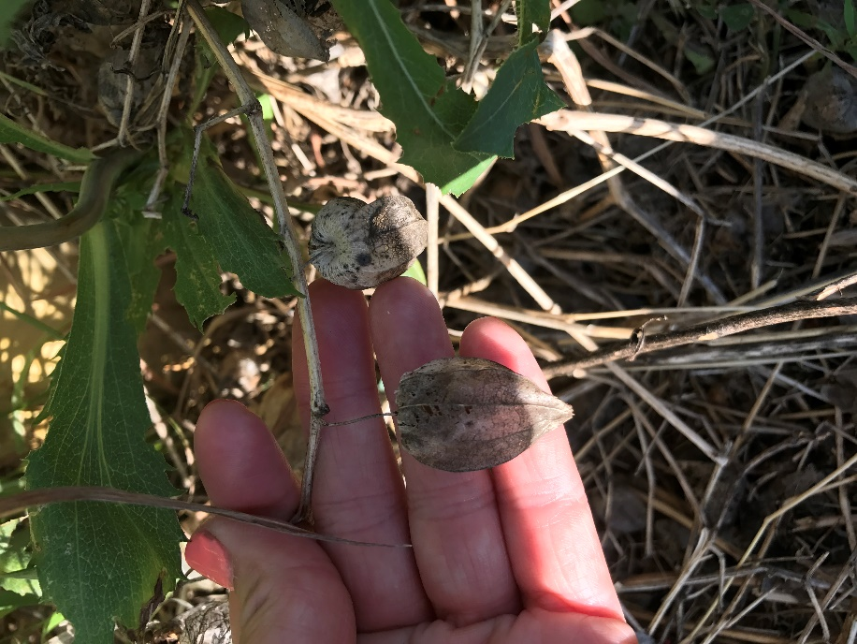
GROUND CHERRIES
Native
Yellow flowers
Papery husk that encloses the fruit
Pies, jams

Slide 19
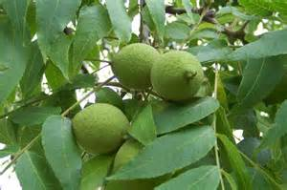
BLACK WALNUTS
Native
Tree
Remove husk
Dry nuts in the sun and cure for a week
Chop in salad or pasta,

Slide 20
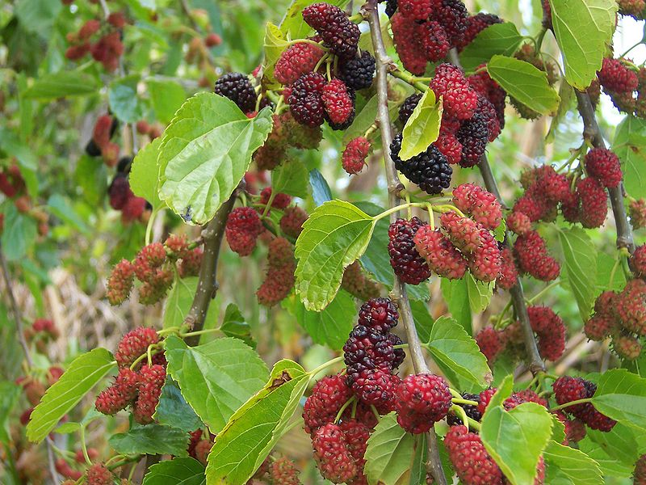
MULBERRY
Tree
Native
Edible berries
Jelly, pies

Slide 21
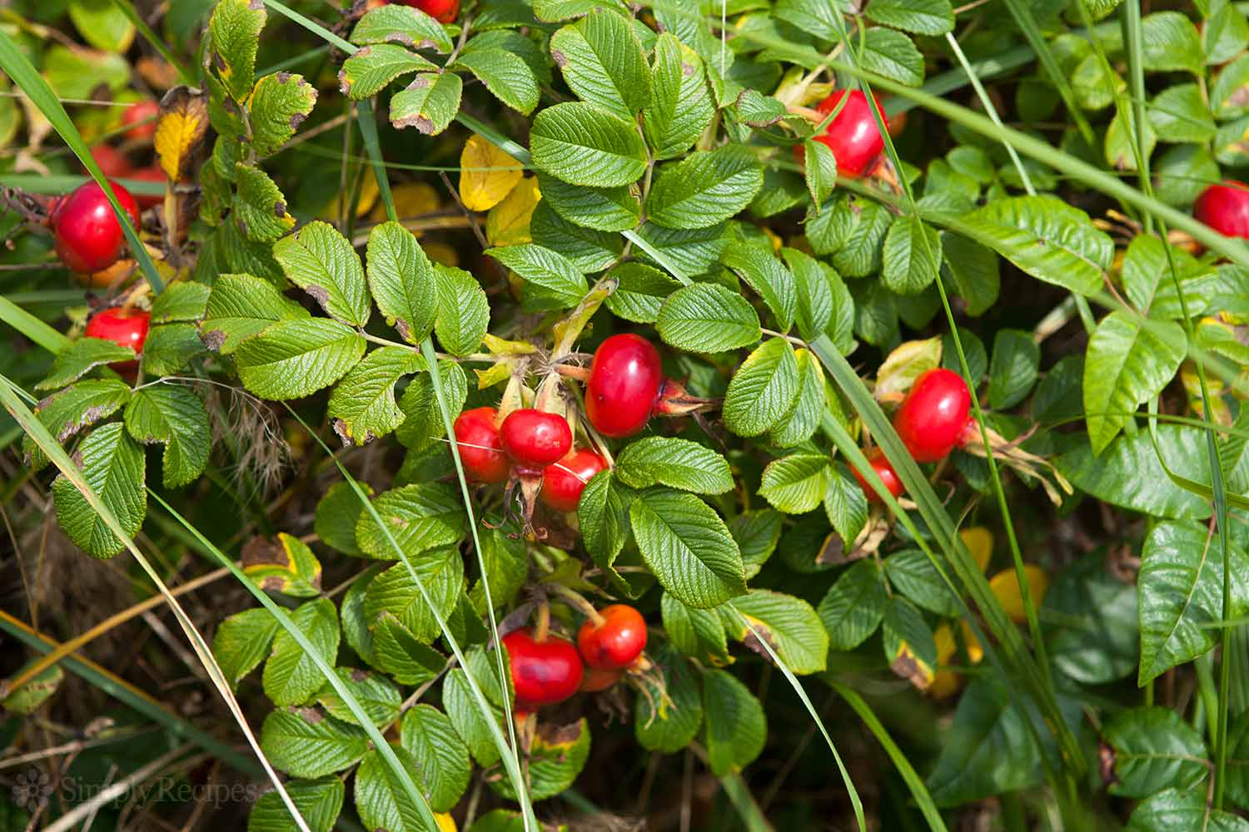
ROSE HIPS
Native
Fruit after flower is pollinated
Fresh or dried, jelly, tea, syrup
Use whole

Slide 22
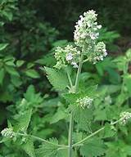
CATNIP
White Flowers spike like clusters
Heart shaped leaves
Stems grooved, 4-sided
Sunny or shady disturbed spots, thickets, roadsides
Minty odor
Tea, flavoring

Slide 23
METHODS FOR SAFE FORAGING
Wear long pants, sturdy shoes, long sleeve shirt
Hat, sunscreen, bug spray, gloves
Kitchen shear, pruner, garden trowel
Container or bag

Slide 24
Places to Forage
Your home yard
City parks
Roadsides

Slide 25
THE LIST GOES ON!
There are many edible weeds found in our area. There are too many to cover.

